Slide 1
Pandas

Slide 2
Create a Pandas Series from dictionary, numpy array and list
Understand the relationship between series and a dataframe
Retrieve data from a Padas dataframe as series and dataframe
Retrieve rows, columns, rows and columns
Perform conditional operations on the DataFrame
THE
FOLLOWING
SLIDES
COVER

Slide 3
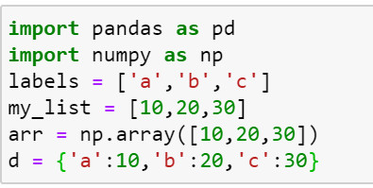
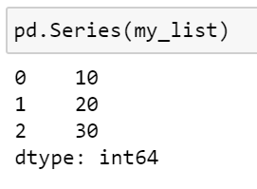
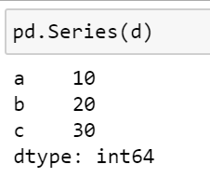
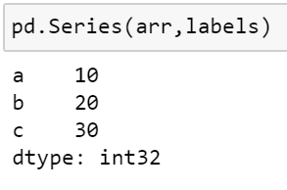
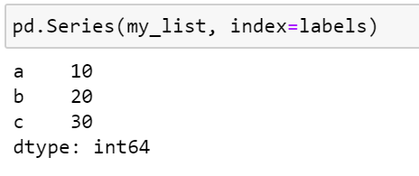
PANDAS SERIES
Creating a Pandas Series
Pandas Series is a one-dimensional labeled array .
It houses heterogeneous data types (integer, string, float, etc.).
The axis label is called as index
Pandas Series may be thought of as a column in an excel sheet
Let us define a dictionary, a list and a NumPy array
3. To create a Series from a list,
pass the list as an argument
1. Create a Series from
a dictionary
2. Create a Series from
a NumPy array

Slide 4
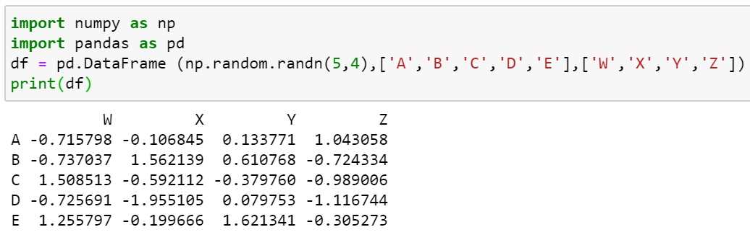
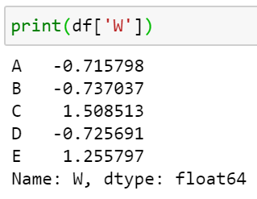
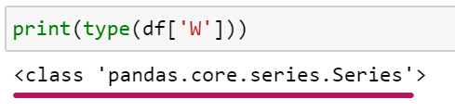
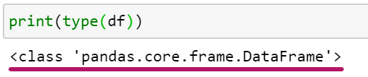
Two-dimensional, size-mutable, potentially heterogeneous tabular data.
It contains labeled axes (rows and columns).
Arithmetic operations align on both row and column labels.
Data Frame is built on top of Series object
An individual row is a pandas Series
An individual column is a pandas Series
PANDAS DATAFRAME
This data frame could be though
of as a collection of series.
Let’s confirm our understanding
Creating a pandas Data Frame
Pd.DataFrame(data, columns =[‘W’,’X’,’Y’,’Z’], index =[‘A’,’B’,’C’,’D’,’E’]

Slide 5
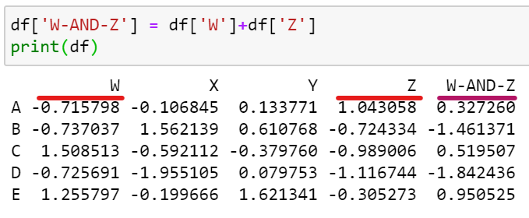
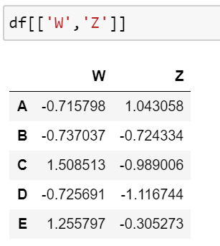
Assume we need to pull a new column, which is a sum of two existing columns (W & Z)
RETREIVAL
To extract, more than one column
from the Data Frame

Slide 6
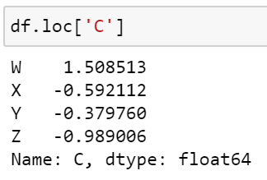
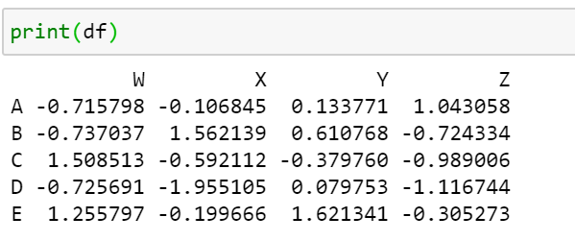
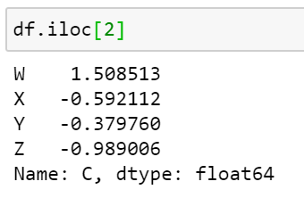
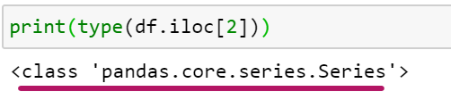
SELECTING ROWS
Rows can be selected by
1. Referencing the Row NameDataFrame.loc[‘Row-Name’]
2. Referencing the index location of the Row DataFrame.iloc[‘Index value’]
A type() of the row, proves that rows are a pandas
Series too.

Slide 7
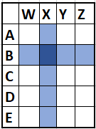
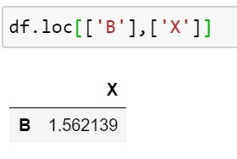
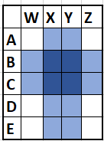
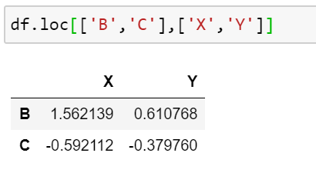
SELECTING A SUBSET OF ROWS AND COLUMNS

Slide 8
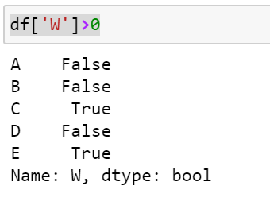
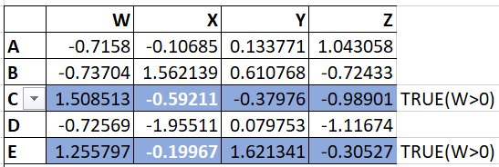
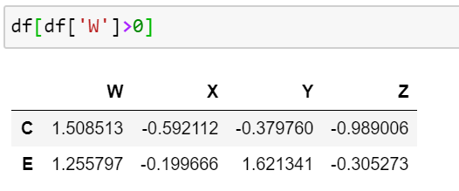
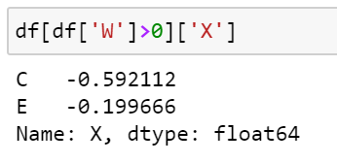
DataFrame
1. Rows where the value of ‘W’ > 0
is returned as a TRUE
CONDITIONAL SELECTION
3. Return the values of column X where, where value in column W
Is greater than 0
2. Return the rows where the value in a column,
meets a certain condition - (df[‘W’])>0

Slide 9
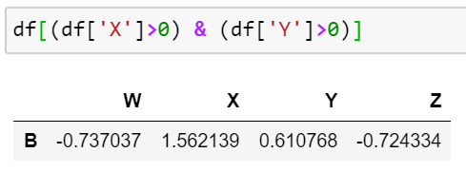
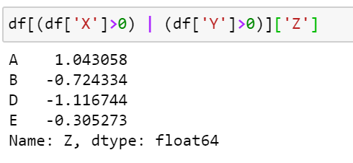
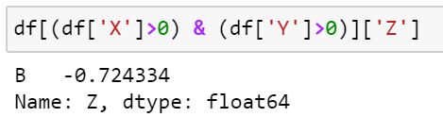
4. Bringing together conditional statements (using AND, OR)
a. Rows where value in the columns X and Y are both greater than 0
C. Value of Z, where value in either the column X OR Y are is greater than 0
b. Value of Z, where value in the columns X and Y are both greater than 0

Slide 10
ACTION NULL VALUES

Slide 11
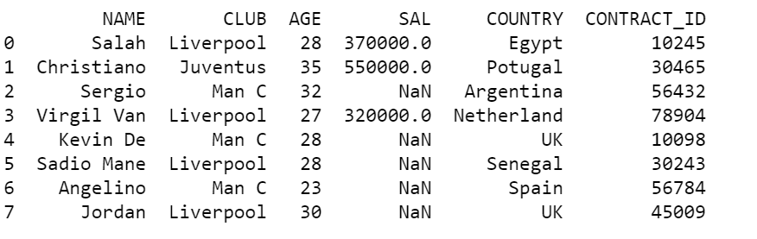
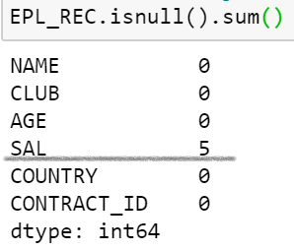
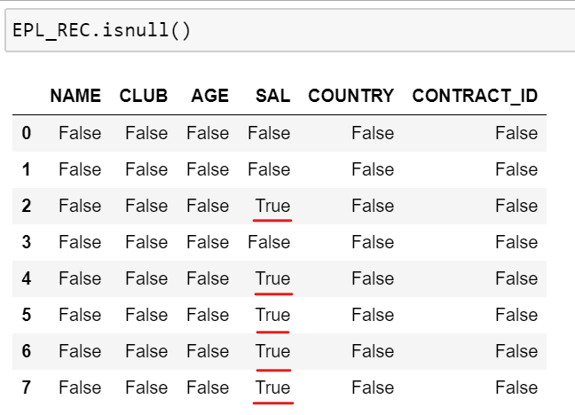
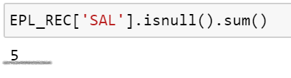
Working with Missing Values
DataFrame
Count of missing values in a
DataFrame
OPERATIONS ON A DATAFRAME
3. Find the missing values
DataFrame.isnull()
2. Count of missing values in a
DataFrame column

Slide 12
NaN implies un-defined or missing value in a Pandas DataFrame, Upon encountering null values, we could
Populate Null values
Drop Rows containing Null values etc
However, before we action Null Values it is important to understand the dataset at hand and the problem statement
ACTION NULL VALUES
Drop any row with a Null Value
DataFrame.dropna(axis=0, inplace=True)
Drop any Column with a Null Value
DataFrame.dropna(axis=1, inplace=True)
3. Restrict the number of rows/columns
dropped
DataFrame.dropna(axis=1, thresh=2, inplace=True)
Thresh specifies the minimum number of nan values to be dropped
**inplace=True; ensures the changes are permanent

Slide 13
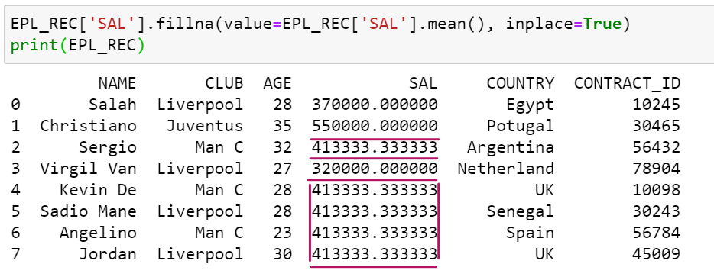
Populate a Null Value(s)
In the dataset at hand, I prefer to populate the missing salary
values with the mean of data (salary values) available
ACTION NULL VALUES
**inplace=True; ensures the changes are permanent

Slide 14
DESCRIPTIVE DATA ANALYSIS

Slide 15
Many a times, it so happens that data we acquire data, without much background, so in this slide- my intention is to
help you leverage items we learnt thus far and make some meaningful conclusions.
The dataset, that I shall be working on – is from ESPN – cricket 2019 stats
Data
Code
From the attached spreadsheet, we try to make the below analysis
Import data from excel(we shall study this later in the course )
Glance through the dataset, to understand the kind of data
Describe the dataset – to get an overall understanding of the numerical columns
Find the number of rows in the dataset
Find the count of unique countries
The number of occurrence of each country
Which country scored the maximum sum total of runs, arranged in descending
Filter out the player, country and runs , where the run scored by a player in greater than mean of the runs in the dataframe
Filter out the player, country and runs , where the run scored by a player in greater than mean of the runs in the dataframe
and the country is in India or West Indies
10. Filter out the player, country and runs of the highest scorer
11. Filter out the player, country and runs of the lowest scorer

Slide 16
GROUP BY AND AGGREGATE FUNCTIONS

Slide 17
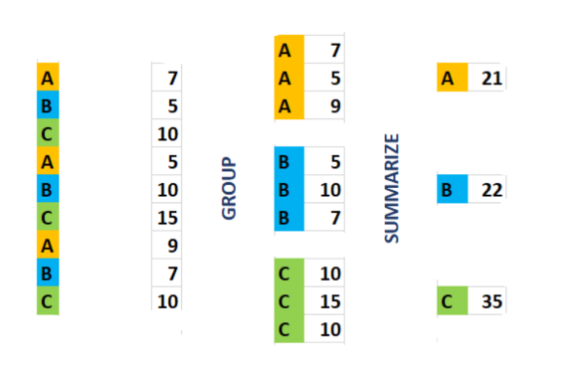
Col::1
Col::2
Mechanics of GROUP BY
The mechanics of a GROUP BY involves
Step -1 Creating a group by object
Step -2 Summarise the data based on a group by object

Slide 18
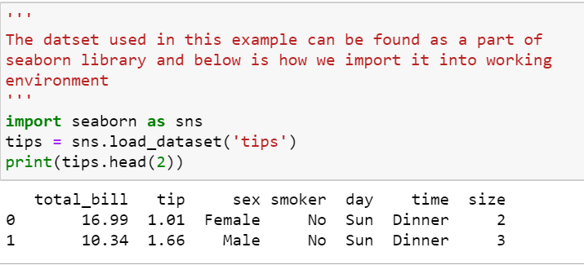
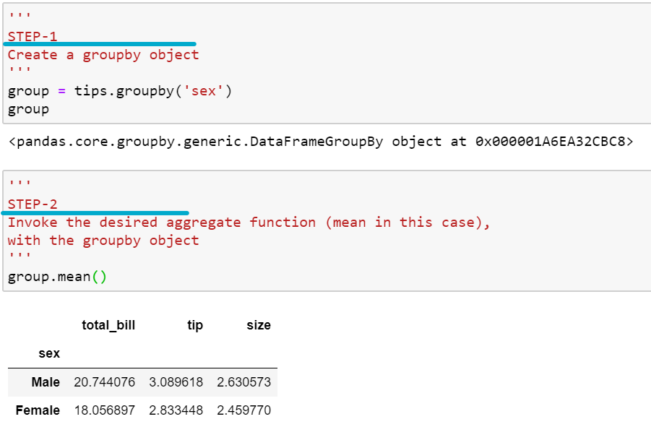
The Dataset that we shall work on
Step-1
Create a group by object
Step-2
Perform the group by aggregation

Slide 19
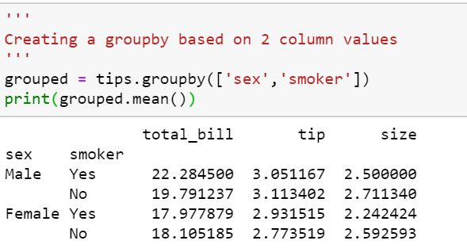
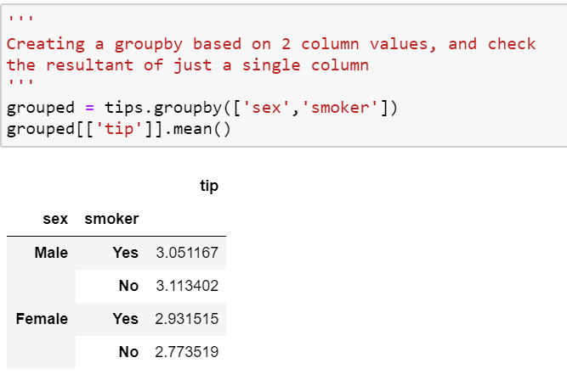
Creating a group by object from 2 columns
Find the grouped stats of a single columns – “tip” in this case

Slide 20
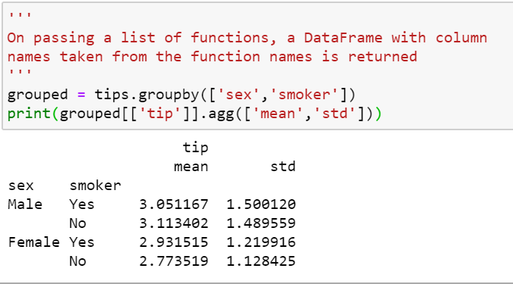
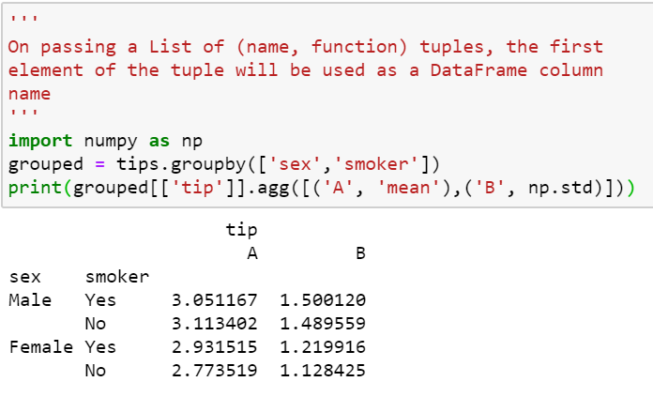
Provide the mean and standard deviation
of tip, grouped by ‘sex’ and ‘smoker’
Provide the mean and standard deviation
of tip, grouped by ‘sex’ and ‘smoker’.
Rename mean as A & standard deviation as B

Slide 21
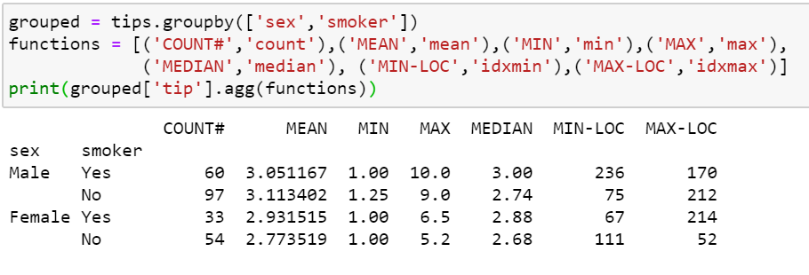
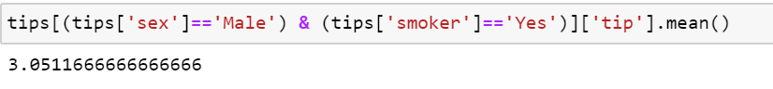
Group the data by ‘sex’ and ‘smoker’
Define the function alias and function names
Club the groupby object + column and the
agg. Functions as shown
Well ! The below is just so you know !

Slide 22
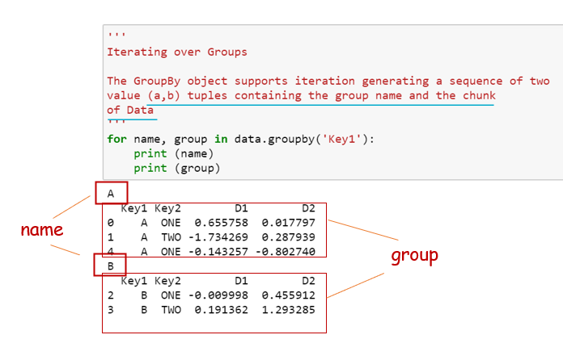
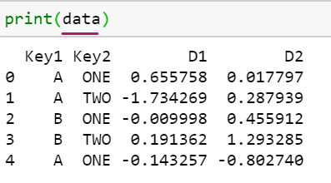
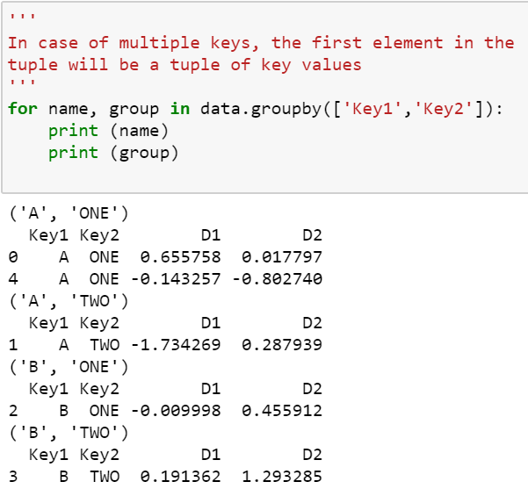
GROUP BY USING ITERATION

Slide 23
Method | Description
count | Number of non-NA values
Describe | Compute set of summary statistics for each column
Min, max | minimum and max. values
Argmin, argmax | Compute the index location (integer) for max/min values
Idxmin, idxmax | Compute the index values for max/min values
Quantile | Compute sample quantile ranging from 0-1
Sum | Sum of values
Mean | Mean of values
Median | Arithmetic median (50% quantile) of values
Mad | Mean absolute deviation for mean value
Var | Simple variance of values
Std | Simple standard deviation of values
Cumsum | Cumulative sum of values
Cummin, cummax | Cumulative minimum or maximum values respectively
Cumprod | Cumulative product of values
Diff | Compute first arithmetic difference (used with time series)
Pct_change | Compute percent change
Prod | Computes the product
First, Last | First and Last non-NA values
DESCRIPTIVE STATISTICS FUNCTIONS

Slide 24
MERGE & CONCATENATE DATASETS

Slide 25
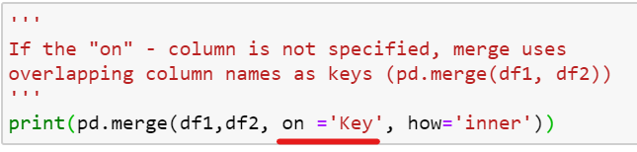
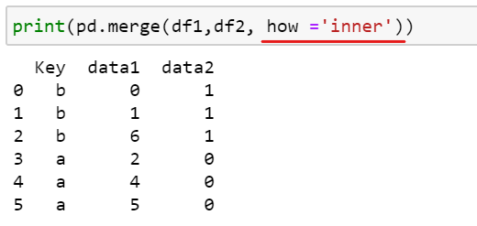
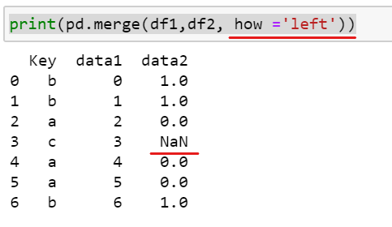
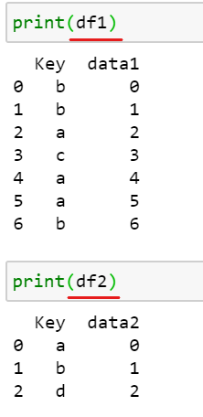
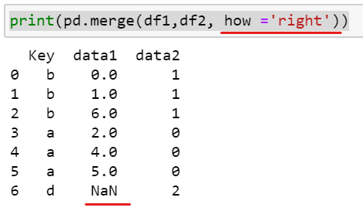
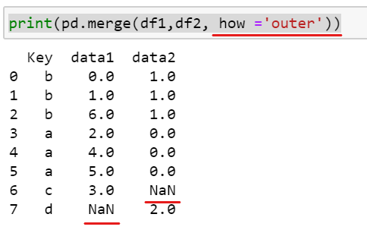
SQL like joins – bringing all in one slide
Merge on KEY
Merge on key values common to both datasets
Merge on key values present in the left Data Frame,
Data Frame
INNER
LEFT
Merge on key values present in the right Data Frame,
If the – key in right Data Frame does not have a value in
the left Data Frame – populate as NaN
Keys in both left & right Data Frames are taken into account.
Check how NaN values get populated
MERGE DATASETS
RIGHT
OUTER

Slide 26
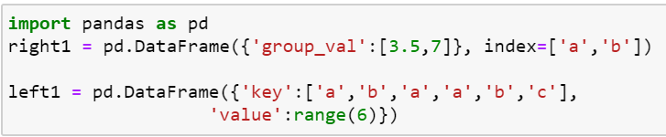




When the keys – to be merged on – is an index, pass left_index=True or right_index=True (or both)
to indicate that the Index should be used as the merge key
Merge on Index
Data Set 1
Data Set 2
MERGE DATASETS

Slide 27





1
Note the handling of duplicate index values
Merge on Hierarchical Index
Data Set 1
Data Set 2
2
MERGE DATASETS

Slide 28



Pandas.concat
Concatenation operation involves binding, combining or Stacking together of data, along rows or columns
1
By default, concatenation is performed on rows (axis=0)
2
3
CONCATENATE DATASETS
Concatenating the same datasets
along columns (axis=1)

Slide 29




1
Adding a new series S4
3
2
CONCATENATE DATASETS

Slide 30
PIVOT TABLES & RESHAPING

Slide 31


Pivot table is a data summarization tool frequently found in spreadsheet and other data analysis software, It aggregates a table Of data by
one or more keys, arranging the data in a rectangle with some of the group keys along the rows and some along the column
Taking into account, the tips dataset that forms a part of seaborn library datasets.
CODE HERE
The below performs a hierarchical indexing of the data
Grouping by sex and whether the person is smoker.
Post grouping – it calculates the group means (default behaviour)
1
PIVOT TABLES

Slide 32


2
Mean values of
The size of the table
Tip percentage tip
Grouped by the sex and day dataframe
Split by whether a person is a smoker or not
A new argument “margins = True” (provides a new column-
Ignoring the fact whether a person smoker or not
3
PIVOT TABLES

Slide 33


4
To use an aggregation function other than the default of mean,
Explicitly specify the aggregation function using “aggfunc=XXX”
5
Populate the missing values using fill_value=0
PIVOT TABLES

Slide 34



Reshaping one of the data sets available in python seaborn library
1
When the data is not stored in the desired format.
Pivot tables can be used to reshape data to a
desired format
3
PIVOT TO RESHAPE
2

Slide 35



Re-arrange or reshape tabular data
1
2
3
RESHAPING

Slide 36
PIVOT TABLES
Function Name | Description
Values | Column names of names to aggregate, by default aggregate all numeric values
Rows | Column names or other group keys to group on the rows of the resulting pivot table
Cols | Column names or other group keys to group on the columns of the resulting pivot table
Aggfunc | Aggregate function or list of functions; ‘mean’ by default, can be any function valid in groupby context
Fill value | Replace missing values in result table
Margins | Add row/column subtotals and grand total, False by default

Slide 37
BINNING AND QUANTILE ANALYSIS

Slide 38


Data Set
PANDAS CUT
CODE HERE
1
2
3
BUCKETING DATA - BINNING
1 Define Bins
2 Define Labels for the bin
3 Cut the goals - column into
Bins and label them into groups

Slide 39


PANDAS QCUT
Pandas qcut is a Quantile-based discretization function. It bins variable into equal-sized buckets based on rank or based on sample quantiles
BUCKETING DATA - QUANTILE
In the background, GOALS column gets divided into 5 quantiles and labelled as pe the arguments passed
(5, interval[float64]):
[(8.999, 23.6] < (23.6, 31.2] < (31.2, 35.2]
< (35.2, 40.4] < (40.4, 50.0]]

Slide 40
IMPORT AND EXPORT DATA

Slide 41


This shall be discussed at length once we start working with real world analytics
Whilst python can connect with most (if not all) data sources, we shall discuss the below
CSV file
Excel File
html file
In my next course, I discuss web scraping, reading stock OHLCV data through web api,
connecting to a database and more.
Here is a brief introduction on how we retrieve OHLCV data from yahoo financials
IMPORT STOCK DATA FROM WEB

Slide 42

1
CSV
2
3
EXCEL
4
DATA IMPORT
5
HTML

Slide 43




4
1
2
3
DATA EXPORT

Slide 44



To be discussed at length in the Datetime section
1. Set Date as an index at the time of file import
1
EXAMPLE FILE
2
After import
a
b
c
d
IMPORT DATA WITH DATETIME INDEX
e
2. Set Date as an index after import
Import the file
Do an df.info() – Date is just another column
Use the pd.to_datetime function
Set index
Do a df.info() to confirm
2

Slide 45
WORKING WITH TIME SERIES DATA

Slide 46


EXTRACT INDIVIDUAL DATETIME COMPONENTS
IMPORT
PARSE
CONVERT TO DATETIME
Data
Code

Slide 47


SUBSETTING WITH DATETIME INDEX

Slide 48


SUBSETTING WITH DATETIME INDEX

Slide 49


RESAMPLING WITH DATETIME INDEX

Slide 50

UP AND DOWN SAMPLING WITH DATETIME INDEX

Slide 51

ROLLING VALUES CALCULATION WITH DATETIME INDEX

Slide 52

ROLLING CORRELATION
ROLLING COVARIANCE
EXPONENTIAL MOVING VALUES

Slide 53


SHIFT THROUGH DATETIME INDEX – FORWARD/BACKWARD

Slide 54


CHECK IF THE DATETIME INDEX HAS BEEN DUPLICATED
Read the data-set
Convert date to datetime
Set datetime as index
Groupby datetime.count()
Subset the datetime that has a count>1

Slide 55
Type | Description
%Y | 4-digit year
%y | 2-digit year
%m | 2-digit month [01,12]
%d | 2-digit day [01,30]
%H | Hour (24-hour clock) [00,23]
%I | Hour (12-hour clock) [01,12]
%M | 2-digit minute [00,59]
%S | Second[00,61](seconds 60,61 account for leap seconds)
%w | Weekday as integer [0(Sunday), 6]
%U | Week number of the year[00,53]. Sunday is considered as first day of the week, and days before the first Sunday are “week0”
%W | Week number of the year[00,53]. Monday is considered as first day of the week, and days before the first Monday are “week0”
%z | UTC time zone offset as +HHMM or –HHMM, empty if time zone is naive
%F | Shortcut for %Y-%m-%d, example 2012-4-18
%D | Shortcut for %m%d%y, example – 04/18/12
DATETIME FORMAT SPECIFICATIONS

Slide 56
Alias | Offset Type | Description
D | Day | Calendar daily
B | Business Day | Business Daily
H | Hour | Hourly
T or min | Minute | Minutely
S | Second | Secondly
L or ms | Milli | Millisecond(1/1000 th of a second)
U | Micro | Microsecond(1/1000000 th of a second)
M | Month end | Last calendar day of month
BM | Business Month End | Last Business day (weekday) of month
MS | MonthBegin | First Calendar day of month
BMS | Business Month Begin | First weekday of month
W-MON, W-TUE, … | Week | Weekly on given day of week MON, TUE, WED, THU, FRI, SAT, SUN.
RESAMPLING FREQUENCY

Slide 57
LAMBDA EXPRESSIONS

Slide 58
A lambda function is a function that contains a single expression, It helps execute seemingly complicated tasks with one liners of code.
Characteristics
A Lambda Function in Python programming is an anonymous function or a function having no name.
It is a small and restricted function having no more than one line.
Just like a normal function, a Lambda function can have multiple arguments with one expression.
Every lambda function in Python has 3 essential parts:
The lambda keyword.
The parameters (or bound variables), and
The function body.
The syntax for writing a lambda is: lambda parameter: expression
Lambdas can have any number of parameters, but they are not enclosed in braces.
A lambda can have only 1 expression in its function body, which is returned by default.
Lambdas support IIFE (immediately invoked function execution) thru this syntax: (lambda parameter: expression)(argument)
Lambdas are commonly used with the following python built-ins:
Filter: filter (lambda parameter: expression, iterable-sequence)
Map: map (lambda parameter: expression, iterable-sequences)
Reduce: reduce (lambda parameter1, parameter2: expression, iterable-sequence)
Do not write complicated lambda functions in a production environment because it will be difficult for code-maintainers.
LAMBDA EXPRESSIONS

Slide 59


The filter function is used to select elements from a sequence.
The sequence could be - lists, sets, tuples, a pandas series etc.
The elements which will be selected is based on some pre-defined constraint. It takes 2 parameters:
a. A function that defines the filtering constraint
b. A sequence (any iterator like lists, tuples, etc.)
LAMBDA EXPRESSIONS --- FILTER

Slide 60


A filter(), filters the data from a Pandas series through a Lambda expression
To select the Data Frame, the filter() could be passed as an arguments as shown below
LAMBDA EXPRESSIONS FILTER

Slide 61


The map function is used to apply a particular operation to every element in a sequence.
Like filter(), it also takes 2 parameters:
a. A function that defines the operation to be performed on the elements
b. One or more sequences
LAMBDA EXPRESSIONS MAP

Slide 62


The map() function in Python takes in a function and a list as argument.
The function is called with a lambda function and a list
It returns a new list with the function applied to it
The Salary of all the players have been hiked by 20 %
In this context, it may not make much sense, so we assign the hiked values to the Salary column
LAMBDA EXPRESSIONS MAP
Data

Slide 63

Lambdas in reduce()
---------------------
The reduce function, like map(), is used to apply an operation to every element in a sequence.
However, it differs from the map in its working.
These are the steps followed by the reduce() function to compute an output:
a. Perform the defined operation on the first 2 elements of the sequence.
b. Save this result
c. Perform the operation with the saved result and the next element in the sequence.
d. Repeat until no more elements are left.
It also takes two parameters:
---------------------------
a. A function that defines the operation to be performed
A sequence (any iterator like lists, tuples, Pandas series etc.)
The reduce() function is defined in the ‘functools’ module. Hence, we need to import functools.

Slide 64


Immediately invoked function expressions - Functions invoked as soon as they are created
apply() function calls the lambda function and applies it to every row or column of the data frame and
returns a modified copy of the data frame: Eg- add 3 years to the age of players.
LAMBDA EXPRESSIONS (APPLY)

Slide 65


The reduce() function is defined in the ‘functools’ module. Hence, we need to import functools
The result of addition of first 2 terms get added to the
next until the iteration reaches the very last item in the series
(((((((34+41)+38)+33)+34)+34)+29)+36)
Data
LAMBDA EXPRESSIONS REDUCE

Slide 66

Adding conditional statement – for example if-else logic can be implemented as below
LAMBDA EXPRESSIONS (CONDITIONAL STATEMENTS)

Slide 67



In this exercise we calculate the average px of an equity order by calculating the weighted avg. px of its executions
GROUP WEIGHTED AVERAGE
1
2
3

Slide 68


AGGREGATION ON DATETIME INDEX

